Slide 1



Research Data Analysis with Power BI
Vijay Krishnan - Research Scholar, Anna University
Dr. S. Bharanidharan - Computer Scientist, Anna University
Dr. G. Krishnamoorthy – our Respected Guide & Director,
University Library. Anna University

Slide 2
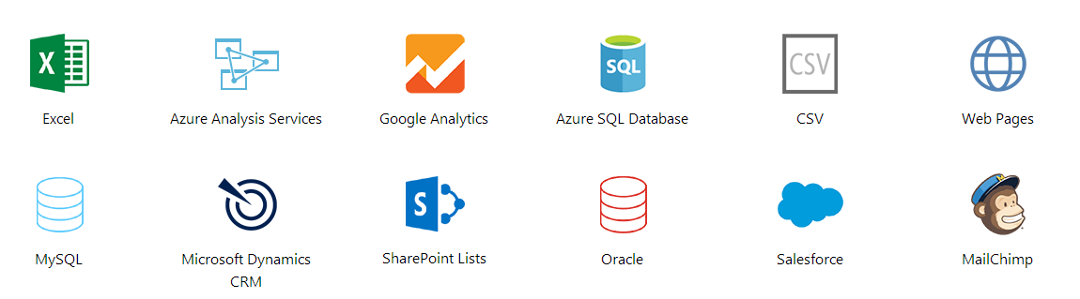
What is Power BI?
Power BI is an online service
Create & share interactive reports and dashboards within and outside organizations
Enables Searching / Transforming / Visualizing data from a wide variety of data sources

Slide 3
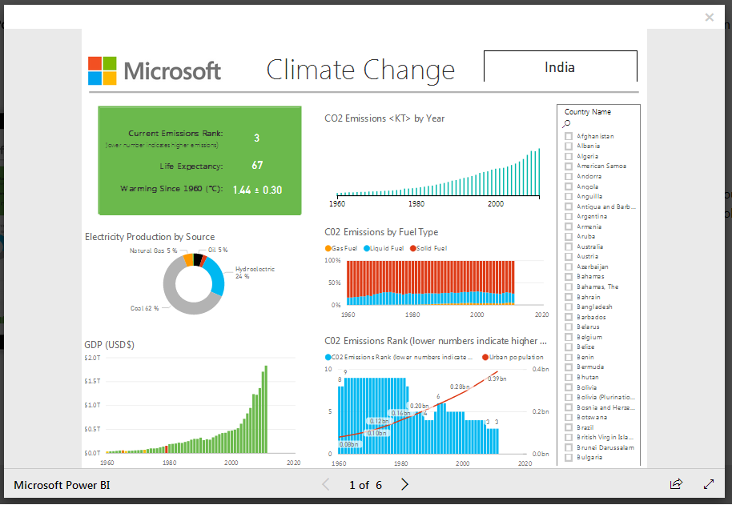
Power BI report sample from PowerBI.com
Features –
+ Visualizations
+ Chart types
+ Filters
+ Interaction
+ Multi-page
+ Automatic Quick Insights

Slide 4
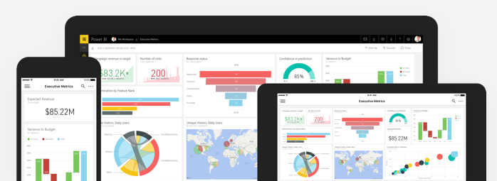
Why use Power BI?
As of February 2017, 200,000+ organizations across 205 countries are using Power BI.
A factor in Gartner positioning Microsoft as a Leader in Business Intelligence and Analytics
Same report can be displayed on Mobiles, Tablets, Laptops and Desktop PCs

Slide 5
Before Artificial Intelligence, reduce Human Errors ☺
Power BI has an advanced Quick Insights feature
Based on a set of analytical algorithms
Automatically build reports based on data analysis
No human intervention needed, apart from clicking Start ☺
Reduce human errors in statistical calculations
=
Deliver verifiable research

Slide 6
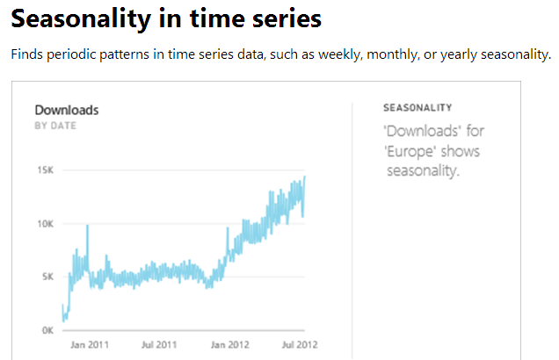
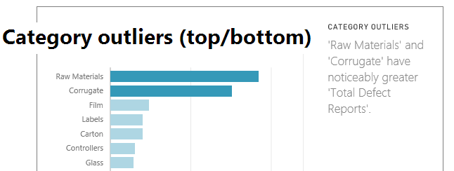
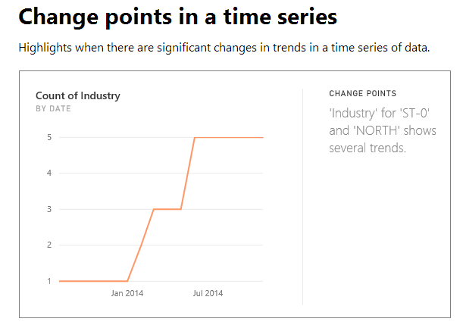
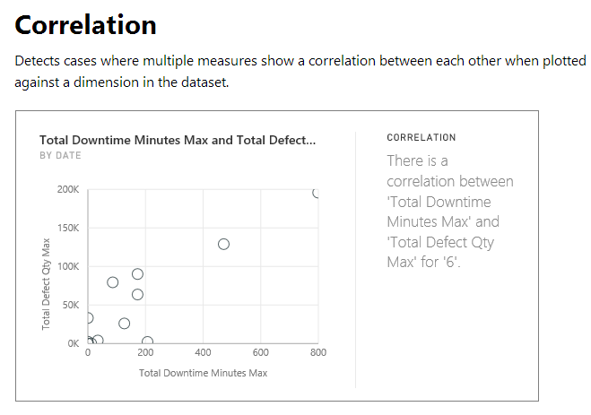
Quick Insights: A few Types (created automatically!)

Slide 7
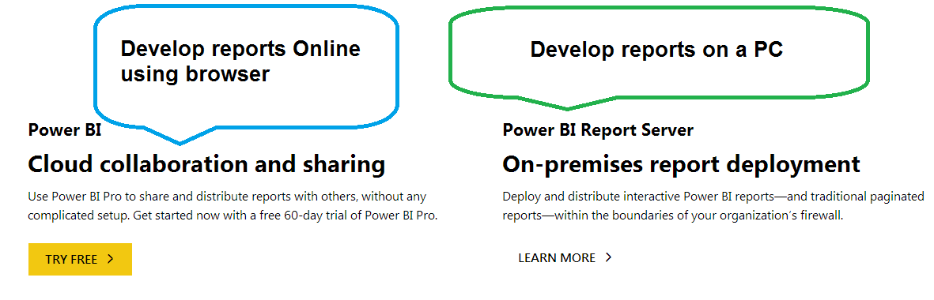
Where to get Power BI?
https://powerbi.microsoft.com/en-us/get-started/
FAQ on software requirements, academic pricing, etc. –
https://powerbi.microsoft.com/en-us/documentation/powerbi-frequently-asked-questions/

Slide 8
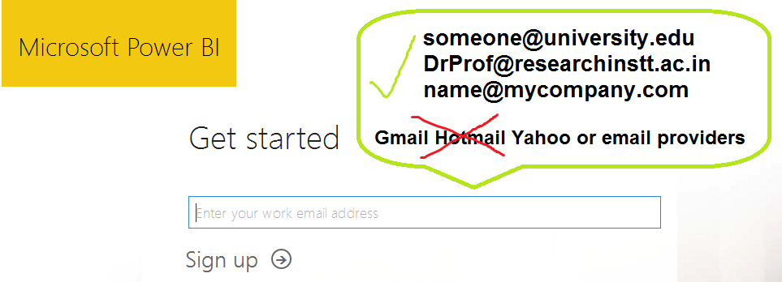
STEP 1: Sign Up (with your Office Email address)

Slide 9
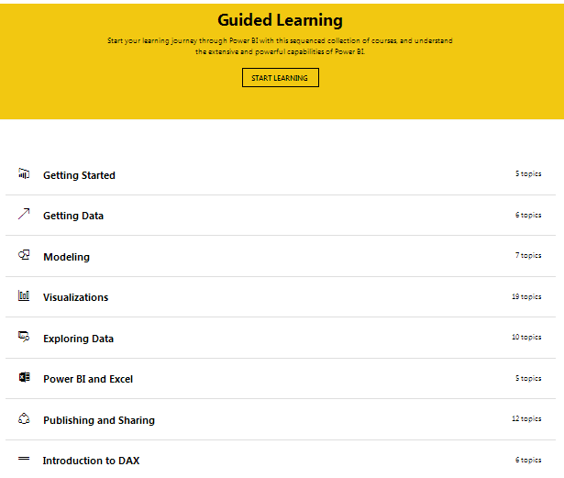
STEP 2:
Learn Power BI
https://powerbi.microsoft.com/en-us/guided-learning/

Slide 10
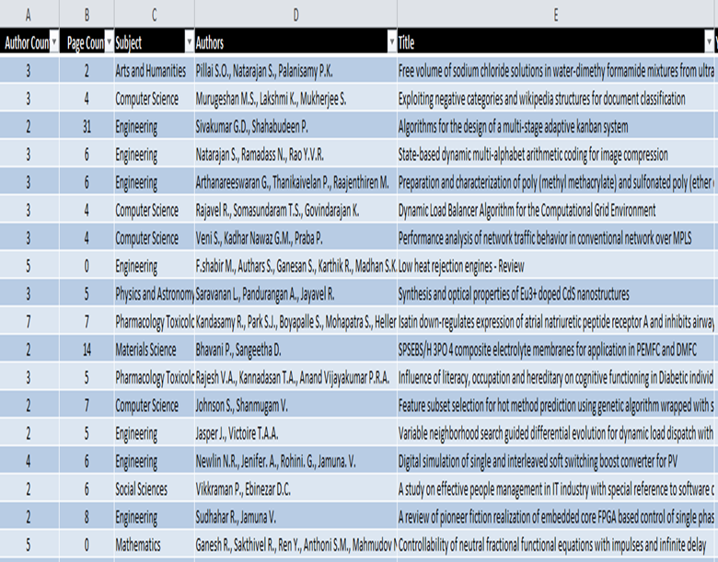
STEP 3: Get Data(Excel/ SQL/ etc.)
Research Data
Author Count
Page Count
Subject
Authors
Title
Year
Source title
Cited by
Affiliations
Authors with affiliations
Abstract
Author Keywords
Index Keywords
Publisher
Conference name
Conference date
Conference location
Language of Original Document
Document Type

Slide 11
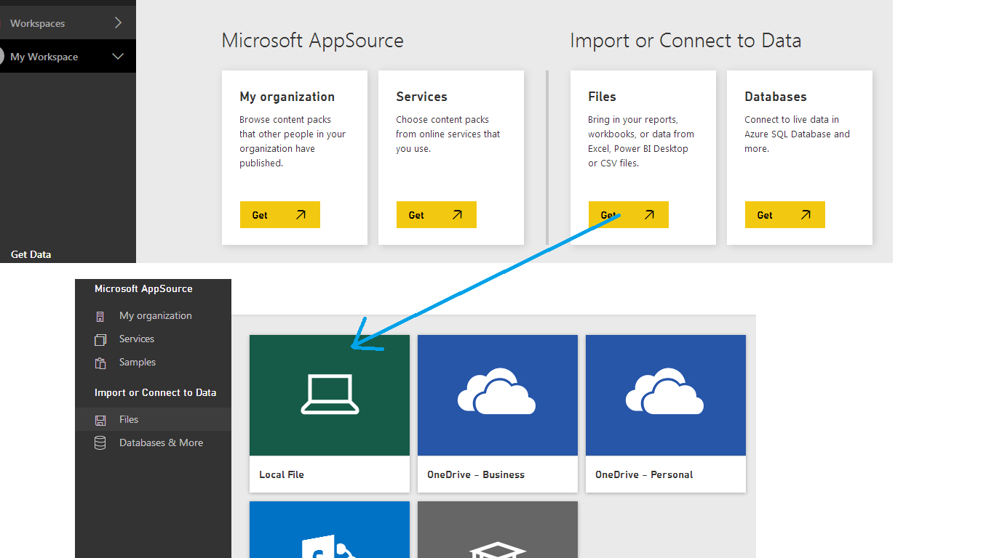
STEP 3: Get Data(Excel/ SQL/ etc.)

Slide 12
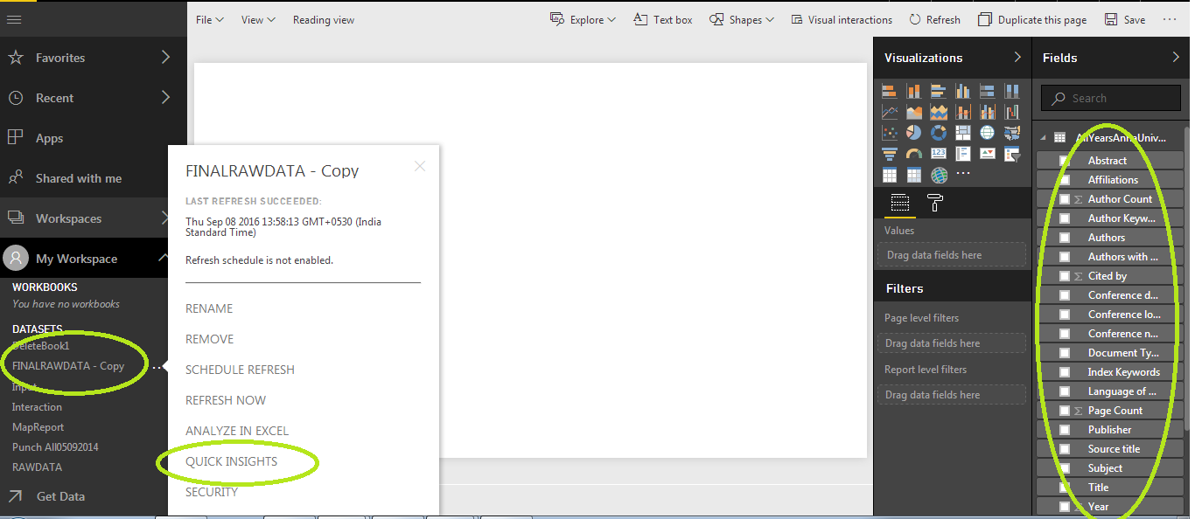
STEP 4: Create Report (Automatically or Manually)

Slide 13
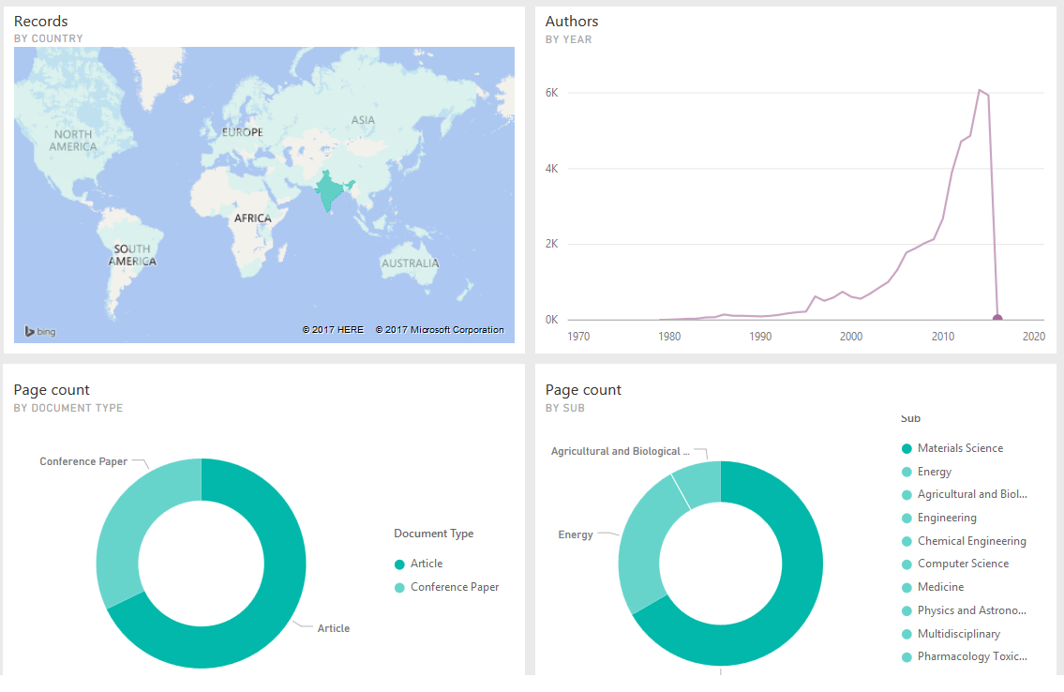
STEP 5:
View & Share Reports/ Dashboards

Slide 14
Conclusion
Power BI is a radical approach to simplifying the business intelligence and data analytics space
Users can easily provide data, build reports or have them automatically created, aggregate them in dashboards, and share it with minimal time and effort.
Delivered by Microsoft, independent verification by Gartner which has compared the competition
Power BI is a unique opportunity for research institutions and professionals to fulfill their data analysis needs.

